Slide 1


Praising Efforts Over Results
Presented by: MRS UDIM INNOCENT
Date: 13TH JUNE 2025
Venue: DUKE AND DUCHESS COLLEGE
IKOT EKPENE
….restoring the self confidence of the Nigerian child
Cultivating Resilience and Growth in Secondary School Students

Slide 2


Slide 3


Praising Efforts Over Results
Why Does This Matter?
….restoring the self confidence of the Nigerian child
Cultivating Resilience and Growth in Secondary School Students
Notes:
Resilience and growth matter in academic performance because they:
Enhance coping skills: Resilience helps students manage stress, setbacks, and failures.
2. Foster persistence: Students with a growth mindset persist in the face of challenges.
3. Promote learning: Growth mindset encourages students to view challenges as opportunities for growth.
4. Improve motivation: Believing in one's ability to learn and grow boosts motivation.
5. Support academic achievement: Resilience and growth mindset contribute to better grades, retention, and overall academic success.By developing resilience and a growth mindset,
students can:
1.Overcome obstacles: Navigate academic challenges with confidence.
2. Develop a love for learning: View challenges as opportunities for growth.
3. Achieve their potential: Reach their academic goals and beyond

Slide 4
Praising Efforts Over Results
Why Does This Matter?
Praising children for their effort, rather than just the outcome, is crucial for building self-confidence because it fosters a
….restoring the self confidence of the Nigerian child
Cultivating Resilience and Growth in Secondary School Students
1. Growth Mindset.
Notes:
Resilience and growth matter in academic performance because they:
Enhance coping skills: Resilience helps students manage stress, setbacks, and failures.
2. Foster persistence: Students with a growth mindset persist in the face of challenges.
3. Promote learning: Growth mindset encourages students to view challenges as opportunities for growth.
4. Improve motivation: Believing in one's ability to learn and grow boosts motivation.
5. Support academic achievement: Resilience and growth mindset contribute to better grades, retention, and overall academic success.By developing resilience and a growth mindset,
students can:
1.Overcome obstacles: Navigate academic challenges with confidence.
2. Develop a love for learning: View challenges as opportunities for growth.
3. Achieve their potential: Reach their academic goals and beyond

Slide 5
Praising Efforts Over Results
Why Does This Matter?
Praising children for their effort, rather than just the outcome, is crucial for building self-confidence because it fosters a
….restoring the self confidence of the Nigerian child
Cultivating Resilience and Growth in Secondary School Students
2. resilience.
Notes:
Resilience and growth matter in academic performance because they:
Enhance coping skills: Resilience helps students manage stress, setbacks, and failures.
2. Foster persistence: Students with a growth mindset persist in the face of challenges.
3. Promote learning: Growth mindset encourages students to view challenges as opportunities for growth.
4. Improve motivation: Believing in one's ability to learn and grow boosts motivation.
5. Support academic achievement: Resilience and growth mindset contribute to better grades, retention, and overall academic success.By developing resilience and a growth mindset,
students can:
1.Overcome obstacles: Navigate academic challenges with confidence.
2. Develop a love for learning: View challenges as opportunities for growth.
3. Achieve their potential: Reach their academic goals and beyond

Slide 6
Praising Efforts Over Results
Why Does This Matter?
Praising children for their effort, rather than just the outcome, is crucial for building self-confidence because it fosters a
….restoring the self confidence of the Nigerian child
Cultivating Resilience and Growth in Secondary School Students
3. Intrinsic motivation
Notes:
Resilience and growth matter in academic performance because they:
Enhance coping skills: Resilience helps students manage stress, setbacks, and failures.
2. Foster persistence: Students with a growth mindset persist in the face of challenges.
3. Promote learning: Growth mindset encourages students to view challenges as opportunities for growth.
4. Improve motivation: Believing in one's ability to learn and grow boosts motivation.
5. Support academic achievement: Resilience and growth mindset contribute to better grades, retention, and overall academic success.By developing resilience and a growth mindset,
students can:
1.Overcome obstacles: Navigate academic challenges with confidence.
2. Develop a love for learning: View challenges as opportunities for growth.
3. Achieve their potential: Reach their academic goals and beyond

Slide 7
Praising Efforts Over Results
Why Does This Matter?
Praising children for their effort, rather than just the outcome, is crucial for building self-confidence because it fosters a
….restoring the self confidence of the Nigerian child
Cultivating Resilience and Growth in Secondary School Students
4. A safe space for mistakes
Notes:
Resilience and growth matter in academic performance because they:
Enhance coping skills: Resilience helps students manage stress, setbacks, and failures.
2. Foster persistence: Students with a growth mindset persist in the face of challenges.
3. Promote learning: Growth mindset encourages students to view challenges as opportunities for growth.
4. Improve motivation: Believing in one's ability to learn and grow boosts motivation.
5. Support academic achievement: Resilience and growth mindset contribute to better grades, retention, and overall academic success.By developing resilience and a growth mindset,
students can:
1.Overcome obstacles: Navigate academic challenges with confidence.
2. Develop a love for learning: View challenges as opportunities for growth.
3. Achieve their potential: Reach their academic goals and beyond

Slide 8
If we praise the efforts children put into their studies, they will develop
Growth Mindset
Resilience
Intrinsic motivation
Safe space for mistakes
….restoring the self confidence of the Nigerian child
Cultivating Resilience and Growth in Secondary School Students
Self - confidence
Notes:
Resilience and growth matter in academic performance because they:
Enhance coping skills: Resilience helps students manage stress, setbacks, and failures.
2. Foster persistence: Students with a growth mindset persist in the face of challenges.
3. Promote learning: Growth mindset encourages students to view challenges as opportunities for growth.
4. Improve motivation: Believing in one's ability to learn and grow boosts motivation.
5. Support academic achievement: Resilience and growth mindset contribute to better grades, retention, and overall academic success.By developing resilience and a growth mindset,
students can:
1.Overcome obstacles: Navigate academic challenges with confidence.
2. Develop a love for learning: View challenges as opportunities for growth.
3. Achieve their potential: Reach their academic goals and beyond

Slide 9

Praising Efforts Over Results
WHAT IS A Growth Mindset ?
….restoring the self confidence of the Nigerian child
Cultivating Resilience and Growth in Secondary School Students
Notes:
Resilience and growth matter in academic performance because they:
Enhance coping skills: Resilience helps students manage stress, setbacks, and failures.
2. Foster persistence: Students with a growth mindset persist in the face of challenges.
3. Promote learning: Growth mindset encourages students to view challenges as opportunities for growth.
4. Improve motivation: Believing in one's ability to learn and grow boosts motivation.
5. Support academic achievement: Resilience and growth mindset contribute to better grades, retention, and overall academic success.By developing resilience and a growth mindset,
students can:
1.Overcome obstacles: Navigate academic challenges with confidence.
2. Develop a love for learning: View challenges as opportunities for growth.
3. Achieve their potential: Reach their academic goals and beyond

Slide 10
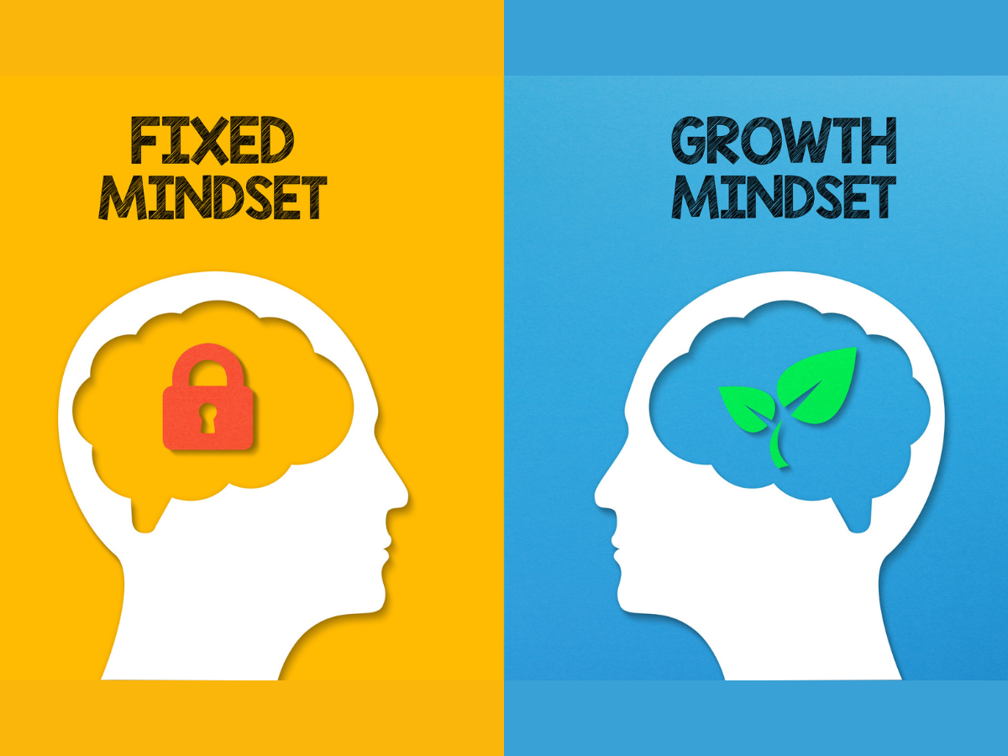
Praising Efforts Over Results
WHAT IS A Growth Mindset?
….restoring the self confidence of the Nigerian child
Cultivating Resilience and Growth in Secondary School Students
Notes:
Resilience and growth matter in academic performance because they:
Enhance coping skills: Resilience helps students manage stress, setbacks, and failures.
2. Foster persistence: Students with a growth mindset persist in the face of challenges.
3. Promote learning: Growth mindset encourages students to view challenges as opportunities for growth.
4. Improve motivation: Believing in one's ability to learn and grow boosts motivation.
5. Support academic achievement: Resilience and growth mindset contribute to better grades, retention, and overall academic success.By developing resilience and a growth mindset,
students can:
1.Overcome obstacles: Navigate academic challenges with confidence.
2. Develop a love for learning: View challenges as opportunities for growth.
3. Achieve their potential: Reach their academic goals and beyond

Slide 11
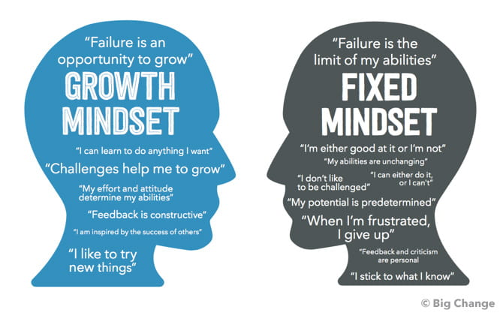
Praising Efforts Over Results
WHAT IS A Growth Mindset
?
….restoring the self confidence of the Nigerian child
Notes:
Resilience and growth matter in academic performance because they:
Enhance coping skills: Resilience helps students manage stress, setbacks, and failures.
2. Foster persistence: Students with a growth mindset persist in the face of challenges.
3. Promote learning: Growth mindset encourages students to view challenges as opportunities for growth.
4. Improve motivation: Believing in one's ability to learn and grow boosts motivation.
5. Support academic achievement: Resilience and growth mindset contribute to better grades, retention, and overall academic success.By developing resilience and a growth mindset,
students can:
1.Overcome obstacles: Navigate academic challenges with confidence.
2. Develop a love for learning: View challenges as opportunities for growth.
3. Achieve their potential: Reach their academic goals and beyond

Slide 12
Praising Efforts Over Results
WHAT IS A Growth Mindset
?
….restoring the self confidence of the Nigerian child
A growth mindset is the belief that intelligence and abilities are not fixed
but can be developed through hard work, dedication, and learning.
It's about embracing challenges, viewing failures as opportunities for
learning, and persevering in the face of difficulties
Notes:
Resilience and growth matter in academic performance because they:
Enhance coping skills: Resilience helps students manage stress, setbacks, and failures.
2. Foster persistence: Students with a growth mindset persist in the face of challenges.
3. Promote learning: Growth mindset encourages students to view challenges as opportunities for growth.
4. Improve motivation: Believing in one's ability to learn and grow boosts motivation.
5. Support academic achievement: Resilience and growth mindset contribute to better grades, retention, and overall academic success.By developing resilience and a growth mindset,
students can:
1.Overcome obstacles: Navigate academic challenges with confidence.
2. Develop a love for learning: View challenges as opportunities for growth.
3. Achieve their potential: Reach their academic goals and beyond

Slide 13
Praising Efforts Over Results
Growth Mindset
When children are praised for their effort, they learn that hard work and persistence are valuable.
This fosters a growth mindset, where they believe their abilities can be developed over time through learning and practice
….restoring the self confidence of the Nigerian child
Notes:
Resilience and growth matter in academic performance because they:
Enhance coping skills: Resilience helps students manage stress, setbacks, and failures.
2. Foster persistence: Students with a growth mindset persist in the face of challenges.
3. Promote learning: Growth mindset encourages students to view challenges as opportunities for growth.
4. Improve motivation: Believing in one's ability to learn and grow boosts motivation.
5. Support academic achievement: Resilience and growth mindset contribute to better grades, retention, and overall academic success.By developing resilience and a growth mindset,
students can:
1.Overcome obstacles: Navigate academic challenges with confidence.
2. Develop a love for learning: View challenges as opportunities for growth.
3. Achieve their potential: Reach their academic goals and beyond

Slide 14
Praising Efforts Over Results
….restoring the self confidence of the Nigerian child
Cultivating Resilience and Growth in Secondary School Students
RESILIENCE
Notes:
Resilience and growth matter in academic performance because they:1. Enhance coping skills: Resilience helps students manage stress, setbacks, and failures.2. Foster persistence: Students with a growth mindset persist in the face of challenges.3. Promote learning: Growth mindset encourages students to view challenges as opportunities for growth.4. Improve motivation: Believing in one's ability to learn and grow boosts motivation.5. Support academic achievement: Resilience and growth mindset contribute to better grades, retention, and overall academic success.By developing resilience and a growth mindset, students can:1. Overcome obstacles: Navigate academic challenges with confidence.2. Develop a love for learning: View challenges as opportunities for growth.3. Achieve their potential: Reach their academic goals and beyond

Slide 15
Praising Efforts Over Results
….restoring the self confidence of the Nigerian child
Cultivating Resilience and Growth in Secondary School Students
WHAT IS RESILIENCE ?
Notes:
Resilience and growth matter in academic performance because they:1. Enhance coping skills: Resilience helps students manage stress, setbacks, and failures.2. Foster persistence: Students with a growth mindset persist in the face of challenges.3. Promote learning: Growth mindset encourages students to view challenges as opportunities for growth.4. Improve motivation: Believing in one's ability to learn and grow boosts motivation.5. Support academic achievement: Resilience and growth mindset contribute to better grades, retention, and overall academic success.By developing resilience and a growth mindset, students can:1. Overcome obstacles: Navigate academic challenges with confidence.2. Develop a love for learning: View challenges as opportunities for growth.3. Achieve their potential: Reach their academic goals and beyond

Slide 16

RESILIENCE
….restoring the self confidence of the Nigerian child
Cultivating Resilience and Growth in Secondary School Students
Notes:
Resilience and growth matter in academic performance because they:1. Enhance coping skills: Resilience helps students manage stress, setbacks, and failures.2. Foster persistence: Students with a growth mindset persist in the face of challenges.3. Promote learning: Growth mindset encourages students to view challenges as opportunities for growth.4. Improve motivation: Believing in one's ability to learn and grow boosts motivation.5. Support academic achievement: Resilience and growth mindset contribute to better grades, retention, and overall academic success.By developing resilience and a growth mindset, students can:1. Overcome obstacles: Navigate academic challenges with confidence.2. Develop a love for learning: View challenges as opportunities for growth.3. Achieve their potential: Reach their academic goals and beyond

Slide 17
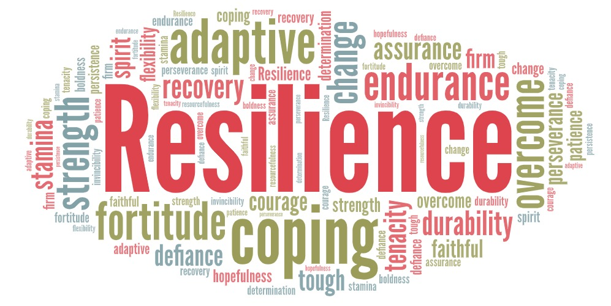
RESILIENCE
….restoring the self confidence of the Nigerian child
Cultivating Resilience and Growth in Secondary School Students
Notes:
Resilience and growth matter in academic performance because they:1. Enhance coping skills: Resilience helps students manage stress, setbacks, and failures.2. Foster persistence: Students with a growth mindset persist in the face of challenges.3. Promote learning: Growth mindset encourages students to view challenges as opportunities for growth.4. Improve motivation: Believing in one's ability to learn and grow boosts motivation.5. Support academic achievement: Resilience and growth mindset contribute to better grades, retention, and overall academic success.By developing resilience and a growth mindset, students can:1. Overcome obstacles: Navigate academic challenges with confidence.2. Develop a love for learning: View challenges as opportunities for growth.3. Achieve their potential: Reach their academic goals and beyond

Slide 18
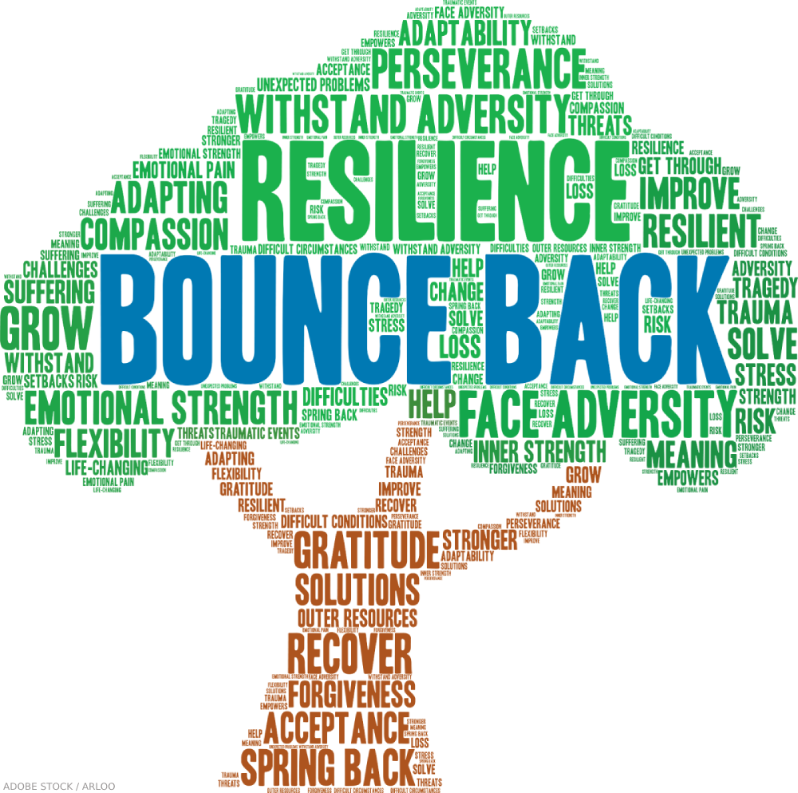
RESILIENCE
….restoring the self confidence of the Nigerian child
Cultivating Resilience and Growth in Secondary School Students
Notes:
Resilience and growth matter in academic performance because they:1. Enhance coping skills: Resilience helps students manage stress, setbacks, and failures.2. Foster persistence: Students with a growth mindset persist in the face of challenges.3. Promote learning: Growth mindset encourages students to view challenges as opportunities for growth.4. Improve motivation: Believing in one's ability to learn and grow boosts motivation.5. Support academic achievement: Resilience and growth mindset contribute to better grades, retention, and overall academic success.By developing resilience and a growth mindset, students can:1. Overcome obstacles: Navigate academic challenges with confidence.2. Develop a love for learning: View challenges as opportunities for growth.3. Achieve their potential: Reach their academic goals and beyond

Slide 19

RESILIENCE
….restoring the self confidence of the Nigerian child
Cultivating Resilience and Growth in Secondary School Students
Describe the picture
Notes:
Resilience and growth matter in academic performance because they:1. Enhance coping skills: Resilience helps students manage stress, setbacks, and failures.2. Foster persistence: Students with a growth mindset persist in the face of challenges.3. Promote learning: Growth mindset encourages students to view challenges as opportunities for growth.4. Improve motivation: Believing in one's ability to learn and grow boosts motivation.5. Support academic achievement: Resilience and growth mindset contribute to better grades, retention, and overall academic success.By developing resilience and a growth mindset, students can:1. Overcome obstacles: Navigate academic challenges with confidence.2. Develop a love for learning: View challenges as opportunities for growth.3. Achieve their potential: Reach their academic goals and beyond

Slide 20
RESILIENCE
….restoring the self confidence of the Nigerian child
Cultivating Resilience and Growth in Secondary School Students
What can you say of this tree?
Notes:
Resilience and growth matter in academic performance because they:1. Enhance coping skills: Resilience helps students manage stress, setbacks, and failures.2. Foster persistence: Students with a growth mindset persist in the face of challenges.3. Promote learning: Growth mindset encourages students to view challenges as opportunities for growth.4. Improve motivation: Believing in one's ability to learn and grow boosts motivation.5. Support academic achievement: Resilience and growth mindset contribute to better grades, retention, and overall academic success.By developing resilience and a growth mindset, students can:1. Overcome obstacles: Navigate academic challenges with confidence.2. Develop a love for learning: View challenges as opportunities for growth.3. Achieve their potential: Reach their academic goals and beyond

Slide 21
RESILIENCE
….restoring the self confidence of the Nigerian child
Cultivating Resilience and Growth in Secondary School Students
Can we see RESILIENCE here?
Notes:
Resilience and growth matter in academic performance because they:1. Enhance coping skills: Resilience helps students manage stress, setbacks, and failures.2. Foster persistence: Students with a growth mindset persist in the face of challenges.3. Promote learning: Growth mindset encourages students to view challenges as opportunities for growth.4. Improve motivation: Believing in one's ability to learn and grow boosts motivation.5. Support academic achievement: Resilience and growth mindset contribute to better grades, retention, and overall academic success.By developing resilience and a growth mindset, students can:1. Overcome obstacles: Navigate academic challenges with confidence.2. Develop a love for learning: View challenges as opportunities for growth.3. Achieve their potential: Reach their academic goals and beyond

Slide 22
RESILIENCE
….restoring the self confidence of the Nigerian child
Cultivating Resilience and Growth in Secondary School Students
Against ALL ODDS, the tree is still coping.
Struggling to SURVIVE.
NOT GIVING UP!!!
Notes:
Resilience and growth matter in academic performance because they:1. Enhance coping skills: Resilience helps students manage stress, setbacks, and failures.2. Foster persistence: Students with a growth mindset persist in the face of challenges.3. Promote learning: Growth mindset encourages students to view challenges as opportunities for growth.4. Improve motivation: Believing in one's ability to learn and grow boosts motivation.5. Support academic achievement: Resilience and growth mindset contribute to better grades, retention, and overall academic success.By developing resilience and a growth mindset, students can:1. Overcome obstacles: Navigate academic challenges with confidence.2. Develop a love for learning: View challenges as opportunities for growth.3. Achieve their potential: Reach their academic goals and beyond

Slide 23
RESILIENCE
Resilience is the ability to adapt well to difficult
situations, challenges, or stressful events, often
involving bouncing back from adversity and
maintaining mental, emotional, and
behavioral well-being.
….restoring the self confidence of the Nigerian child
Cultivating Resilience and Growth in Secondary School Students
Notes:
Resilience and growth matter in academic performance because they:1. Enhance coping skills: Resilience helps students manage stress, setbacks, and failures.2. Foster persistence: Students with a growth mindset persist in the face of challenges.3. Promote learning: Growth mindset encourages students to view challenges as opportunities for growth.4. Improve motivation: Believing in one's ability to learn and grow boosts motivation.5. Support academic achievement: Resilience and growth mindset contribute to better grades, retention, and overall academic success.By developing resilience and a growth mindset, students can:1. Overcome obstacles: Navigate academic challenges with confidence.2. Develop a love for learning: View challenges as opportunities for growth.3. Achieve their potential: Reach their academic goals and beyond

Slide 24
RESILIENCE
Praising effort helps children view setbacks
as opportunities for learning and improvement,
rather than as reflections of their inherent abilities.
This leads to increased resilience and a greater willingness
to try new things even when they are difficult.
thus,
Building SELF - CONFIDENCE
….restoring the self confidence of the Nigerian child
Cultivating Resilience and Growth in Secondary School Students
Notes:
Resilience and growth matter in academic performance because they:1. Enhance coping skills: Resilience helps students manage stress, setbacks, and failures.2. Foster persistence: Students with a growth mindset persist in the face of challenges.3. Promote learning: Growth mindset encourages students to view challenges as opportunities for growth.4. Improve motivation: Believing in one's ability to learn and grow boosts motivation.5. Support academic achievement: Resilience and growth mindset contribute to better grades, retention, and overall academic success.By developing resilience and a growth mindset, students can:1. Overcome obstacles: Navigate academic challenges with confidence.2. Develop a love for learning: View challenges as opportunities for growth.3. Achieve their potential: Reach their academic goals and beyond

Slide 25
Praising Efforts Over Results
….restoring the self confidence of the Nigerian child
Cultivating Resilience and Growth in Secondary School Students
Intrinsic motivation
Notes:
Resilience and growth matter in academic performance because they:1. Enhance coping skills: Resilience helps students manage stress, setbacks, and failures.2. Foster persistence: Students with a growth mindset persist in the face of challenges.3. Promote learning: Growth mindset encourages students to view challenges as opportunities for growth.4. Improve motivation: Believing in one's ability to learn and grow boosts motivation.5. Support academic achievement: Resilience and growth mindset contribute to better grades, retention, and overall academic success.By developing resilience and a growth mindset, students can:1. Overcome obstacles: Navigate academic challenges with confidence.2. Develop a love for learning: View challenges as opportunities for growth.3. Achieve their potential: Reach their academic goals and beyond

Slide 26
motivation
Motivation is the driving force that initiates and sustains
an individual's behavior towards achieving a particular
goal. It can be categorized into two main types:
Extrinsic Motivation and
Intrinsic Motivation
….restoring the self confidence of the Nigerian child
Cultivating Resilience and Growth in Secondary School Students
Notes:
Resilience and growth matter in academic performance because they:1. Enhance coping skills: Resilience helps students manage stress, setbacks, and failures.2. Foster persistence: Students with a growth mindset persist in the face of challenges.3. Promote learning: Growth mindset encourages students to view challenges as opportunities for growth.4. Improve motivation: Believing in one's ability to learn and grow boosts motivation.5. Support academic achievement: Resilience and growth mindset contribute to better grades, retention, and overall academic success.By developing resilience and a growth mindset, students can:1. Overcome obstacles: Navigate academic challenges with confidence.2. Develop a love for learning: View challenges as opportunities for growth.3. Achieve their potential: Reach their academic goals and beyond

Slide 27
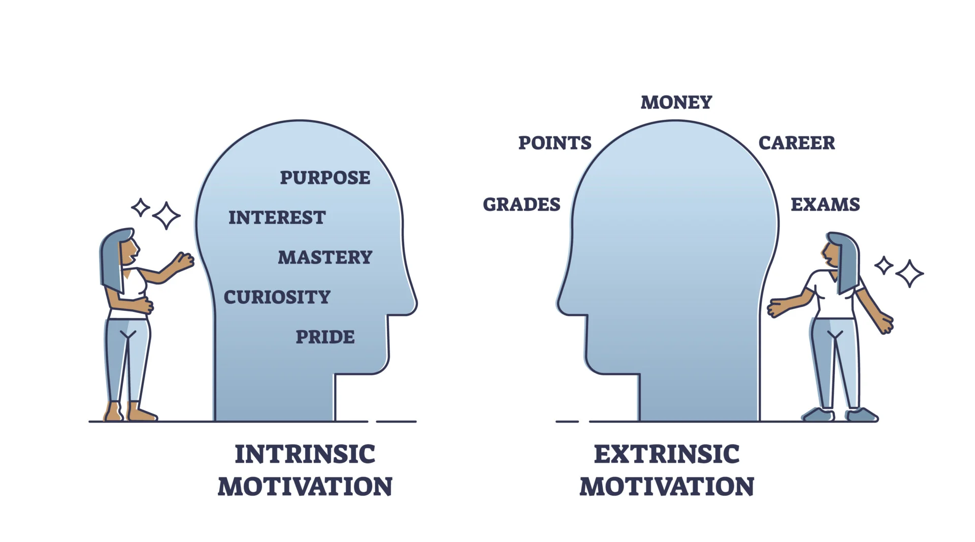
motivation
….restoring the self confidence of the Nigerian child
Cultivating Resilience and Growth in Secondary School Students
Notes:
Resilience and growth matter in academic performance because they:1. Enhance coping skills: Resilience helps students manage stress, setbacks, and failures.2. Foster persistence: Students with a growth mindset persist in the face of challenges.3. Promote learning: Growth mindset encourages students to view challenges as opportunities for growth.4. Improve motivation: Believing in one's ability to learn and grow boosts motivation.5. Support academic achievement: Resilience and growth mindset contribute to better grades, retention, and overall academic success.By developing resilience and a growth mindset, students can:1. Overcome obstacles: Navigate academic challenges with confidence.2. Develop a love for learning: View challenges as opportunities for growth.3. Achieve their potential: Reach their academic goals and beyond

Slide 28
motivation
Extrinsic Motivation
Extrinsic motivation is driven by external factors,
such as rewards, recognition, or pressure from
others.
Examples: Working for a salary, seeking praise
or awards, or meeting expectations.
….restoring the self confidence of the Nigerian child
Cultivating Resilience and Growth in Secondary School Students
Notes:
Resilience and growth matter in academic performance because they:1. Enhance coping skills: Resilience helps students manage stress, setbacks, and failures.2. Foster persistence: Students with a growth mindset persist in the face of challenges.3. Promote learning: Growth mindset encourages students to view challenges as opportunities for growth.4. Improve motivation: Believing in one's ability to learn and grow boosts motivation.5. Support academic achievement: Resilience and growth mindset contribute to better grades, retention, and overall academic success.By developing resilience and a growth mindset, students can:1. Overcome obstacles: Navigate academic challenges with confidence.2. Develop a love for learning: View challenges as opportunities for growth.3. Achieve their potential: Reach their academic goals and beyond

Slide 29
motivation
Intrinsic Motivation
Intrinsic motivation comes from within an individual,
driven by personal interest, enjoyment, or satisfaction.
Examples: Learning for personal growth, creative
expression, or personal challenge.
….restoring the self confidence of the Nigerian child
Cultivating Resilience and Growth in Secondary School Students
Notes:
Resilience and growth matter in academic performance because they:1. Enhance coping skills: Resilience helps students manage stress, setbacks, and failures.2. Foster persistence: Students with a growth mindset persist in the face of challenges.3. Promote learning: Growth mindset encourages students to view challenges as opportunities for growth.4. Improve motivation: Believing in one's ability to learn and grow boosts motivation.5. Support academic achievement: Resilience and growth mindset contribute to better grades, retention, and overall academic success.By developing resilience and a growth mindset, students can:1. Overcome obstacles: Navigate academic challenges with confidence.2. Develop a love for learning: View challenges as opportunities for growth.3. Achieve their potential: Reach their academic goals and beyond

Slide 30
Intrinsic motivation
Intrinsic motivation in children refers to the natural
drive to engage in activities for the inherent enjoyment
and satisfaction they provide, rather than for external
rewards or punishments. It's a self-generated desire
to learn and grow, often fueled by curiosity, a sense
of competence, and a desire for mastery.
….restoring the self confidence of the Nigerian child
Cultivating Resilience and Growth in Secondary School Students
Notes:
Resilience and growth matter in academic performance because they:1. Enhance coping skills: Resilience helps students manage stress, setbacks, and failures.2. Foster persistence: Students with a growth mindset persist in the face of challenges.3. Promote learning: Growth mindset encourages students to view challenges as opportunities for growth.4. Improve motivation: Believing in one's ability to learn and grow boosts motivation.5. Support academic achievement: Resilience and growth mindset contribute to better grades, retention, and overall academic success.By developing resilience and a growth mindset, students can:1. Overcome obstacles: Navigate academic challenges with confidence.2. Develop a love for learning: View challenges as opportunities for growth.3. Achieve their potential: Reach their academic goals and beyond

Slide 31
Intrinsic motivation
Praising the effort a child makes can create a
more intrinsically motivated approach to learning
and problem-solving.
Children are more likely to enjoy the process of learning
when they know that their hard work is appreciated,
regardless of the outcome.
….restoring the self confidence of the Nigerian child
Cultivating Resilience and Growth in Secondary School Students
Notes:
Resilience and growth matter in academic performance because they:1. Enhance coping skills: Resilience helps students manage stress, setbacks, and failures.2. Foster persistence: Students with a growth mindset persist in the face of challenges.3. Promote learning: Growth mindset encourages students to view challenges as opportunities for growth.4. Improve motivation: Believing in one's ability to learn and grow boosts motivation.5. Support academic achievement: Resilience and growth mindset contribute to better grades, retention, and overall academic success.By developing resilience and a growth mindset, students can:1. Overcome obstacles: Navigate academic challenges with confidence.2. Develop a love for learning: View challenges as opportunities for growth.3. Achieve their potential: Reach their academic goals and beyond

Slide 32
Intrinsic motivation
How does Intrinsic Motivation build
a child’s self confidence?
Sense of Control: When children are intrinsically
motivated, they feel a sense of control over their actions
and decisions.
Self-directed Learning: Intrinsic motivation promotes
self-directed learning, allowing children to explore and
learn at their own pace.
Not learning just because of an upcoming examination
….restoring the self confidence of the Nigerian child
Cultivating Resilience and Growth in Secondary School Students
Notes:
Resilience and growth matter in academic performance because they:1. Enhance coping skills: Resilience helps students manage stress, setbacks, and failures.2. Foster persistence: Students with a growth mindset persist in the face of challenges.3. Promote learning: Growth mindset encourages students to view challenges as opportunities for growth.4. Improve motivation: Believing in one's ability to learn and grow boosts motivation.5. Support academic achievement: Resilience and growth mindset contribute to better grades, retention, and overall academic success.By developing resilience and a growth mindset, students can:1. Overcome obstacles: Navigate academic challenges with confidence.2. Develop a love for learning: View challenges as opportunities for growth.3. Achieve their potential: Reach their academic goals and beyond

Slide 33
Intrinsic motivation
How does Intrinsic Motivation build
a child’s self confidence?
Perseverance: Intrinsically motivated children are more
likely to persevere through challenges and setbacks.
Sense of accomplishment: Intrinsic motivated children
experience a sense of accomplishment and pride
in their achievements.
AND MANY MORE !!!!
….restoring the self confidence of the Nigerian child
Cultivating Resilience and Growth in Secondary School Students
Notes:
Resilience and growth matter in academic performance because they:1. Enhance coping skills: Resilience helps students manage stress, setbacks, and failures.2. Foster persistence: Students with a growth mindset persist in the face of challenges.3. Promote learning: Growth mindset encourages students to view challenges as opportunities for growth.4. Improve motivation: Believing in one's ability to learn and grow boosts motivation.5. Support academic achievement: Resilience and growth mindset contribute to better grades, retention, and overall academic success.By developing resilience and a growth mindset, students can:1. Overcome obstacles: Navigate academic challenges with confidence.2. Develop a love for learning: View challenges as opportunities for growth.3. Achieve their potential: Reach their academic goals and beyond

Slide 34
Intrinsic motivation
HOW DO WE PRAISE CHILDREN’S
EFFORTS TO HELP THEM DEVELOP
INTRINSIC MOTIVATION?
….restoring the self confidence of the Nigerian child
Cultivating Resilience and Growth in Secondary School Students
Notes:
Resilience and growth matter in academic performance because they:1. Enhance coping skills: Resilience helps students manage stress, setbacks, and failures.2. Foster persistence: Students with a growth mindset persist in the face of challenges.3. Promote learning: Growth mindset encourages students to view challenges as opportunities for growth.4. Improve motivation: Believing in one's ability to learn and grow boosts motivation.5. Support academic achievement: Resilience and growth mindset contribute to better grades, retention, and overall academic success.By developing resilience and a growth mindset, students can:1. Overcome obstacles: Navigate academic challenges with confidence.2. Develop a love for learning: View challenges as opportunities for growth.3. Achieve their potential: Reach their academic goals and beyond

Slide 35
Praising Efforts Over Results
Giving room FOR MISTAKEs
….restoring the self confidence of the Nigerian child
Cultivating Resilience and Growth in Secondary School Students
Notes:
Resilience and growth matter in academic performance because they:1. Enhance coping skills: Resilience helps students manage stress, setbacks, and failures.2. Foster persistence: Students with a growth mindset persist in the face of challenges.3. Promote learning: Growth mindset encourages students to view challenges as opportunities for growth.4. Improve motivation: Believing in one's ability to learn and grow boosts motivation.5. Support academic achievement: Resilience and growth mindset contribute to better grades, retention, and overall academic success.By developing resilience and a growth mindset, students can:1. Overcome obstacles: Navigate academic challenges with confidence.2. Develop a love for learning: View challenges as opportunities for growth.3. Achieve their potential: Reach their academic goals and beyond

Slide 36
Giving room FOR MISTAKEs
When children are praised for their effort, they
feel safer making mistakes.
WHY?
….restoring the self confidence of the Nigerian child
Cultivating Resilience and Growth in Secondary School Students
Notes:
Resilience and growth matter in academic performance because they:1. Enhance coping skills: Resilience helps students manage stress, setbacks, and failures.2. Foster persistence: Students with a growth mindset persist in the face of challenges.3. Promote learning: Growth mindset encourages students to view challenges as opportunities for growth.4. Improve motivation: Believing in one's ability to learn and grow boosts motivation.5. Support academic achievement: Resilience and growth mindset contribute to better grades, retention, and overall academic success.By developing resilience and a growth mindset, students can:1. Overcome obstacles: Navigate academic challenges with confidence.2. Develop a love for learning: View challenges as opportunities for growth.3. Achieve their potential: Reach their academic goals and beyond

Slide 37
Giving room FOR MISTAKEs
When children are praised for their effort, they
feel safer making mistakes.
WHY?
They understand that mistakes are part
of the learning process and are
not indicative of their overall worth.
….restoring the self confidence of the Nigerian child
Cultivating Resilience and Growth in Secondary School Students
Notes:
Resilience and growth matter in academic performance because they:1. Enhance coping skills: Resilience helps students manage stress, setbacks, and failures.2. Foster persistence: Students with a growth mindset persist in the face of challenges.3. Promote learning: Growth mindset encourages students to view challenges as opportunities for growth.4. Improve motivation: Believing in one's ability to learn and grow boosts motivation.5. Support academic achievement: Resilience and growth mindset contribute to better grades, retention, and overall academic success.By developing resilience and a growth mindset, students can:1. Overcome obstacles: Navigate academic challenges with confidence.2. Develop a love for learning: View challenges as opportunities for growth.3. Achieve their potential: Reach their academic goals and beyond

Slide 38
Giving room FOR MISTAKE
….restoring the self confidence of the Nigerian child
Cultivating Resilience and Growth in Secondary School Students
Praising a child's effort in academics
can help create a safe space
for mistakes in several ways:
Notes:
Resilience and growth matter in academic performance because they:1. Enhance coping skills: Resilience helps students manage stress, setbacks, and failures.2. Foster persistence: Students with a growth mindset persist in the face of challenges.3. Promote learning: Growth mindset encourages students to view challenges as opportunities for growth.4. Improve motivation: Believing in one's ability to learn and grow boosts motivation.5. Support academic achievement: Resilience and growth mindset contribute to better grades, retention, and overall academic success.By developing resilience and a growth mindset, students can:1. Overcome obstacles: Navigate academic challenges with confidence.2. Develop a love for learning: View challenges as opportunities for growth.3. Achieve their potential: Reach their academic goals and beyond

Slide 39

Giving room FOR MISTAKE
Encourages Risk-Taking
1. Reducing fear of failure: When effort is
praised, children feel more comfortable
taking risks and trying new things.
2. Embracing challenges: They become
more willing to tackle difficult
tasks and view challenges as
opportunities for growth.
….restoring the self confidence of the Nigerian child
Cultivating Resilience and Growth in Secondary School Students
Notes:
Resilience and growth matter in academic performance because they:1. Enhance coping skills: Resilience helps students manage stress, setbacks, and failures.2. Foster persistence: Students with a growth mindset persist in the face of challenges.3. Promote learning: Growth mindset encourages students to view challenges as opportunities for growth.4. Improve motivation: Believing in one's ability to learn and grow boosts motivation.5. Support academic achievement: Resilience and growth mindset contribute to better grades, retention, and overall academic success.By developing resilience and a growth mindset, students can:1. Overcome obstacles: Navigate academic challenges with confidence.2. Develop a love for learning: View challenges as opportunities for growth.3. Achieve their potential: Reach their academic goals and beyond

Slide 40
Giving room FOR MISTAKE
Fosters a Growth Mindset
Learning from mistakes: Praising effort
helps children understand that mistakes are
an essential part of the learning process.
2. Developing resilience: They learn to
bounce back from setbacks and
view failures as opportunities for growth.
….restoring the self confidence of the Nigerian child
Cultivating Resilience and Growth in Secondary School Students
Notes:
Resilience and growth matter in academic performance because they:1. Enhance coping skills: Resilience helps students manage stress, setbacks, and failures.2. Foster persistence: Students with a growth mindset persist in the face of challenges.3. Promote learning: Growth mindset encourages students to view challenges as opportunities for growth.4. Improve motivation: Believing in one's ability to learn and grow boosts motivation.5. Support academic achievement: Resilience and growth mindset contribute to better grades, retention, and overall academic success.By developing resilience and a growth mindset, students can:1. Overcome obstacles: Navigate academic challenges with confidence.2. Develop a love for learning: View challenges as opportunities for growth.3. Achieve their potential: Reach their academic goals and beyond

Slide 41
Giving room FOR MISTAKE
Reduces Stress and Anxiety
Shifting focus from grades: Praising effort
helps children focus on the learning process
rather than just grades or outcomes.
2. Building confidence: They develop a sense of
confidence and self-worth that's not solely
dependent on grades or external validation.
….restoring the self confidence of the Nigerian child
Cultivating Resilience and Growth in Secondary School Students
Notes:
Resilience and growth matter in academic performance because they:1. Enhance coping skills: Resilience helps students manage stress, setbacks, and failures.2. Foster persistence: Students with a growth mindset persist in the face of challenges.3. Promote learning: Growth mindset encourages students to view challenges as opportunities for growth.4. Improve motivation: Believing in one's ability to learn and grow boosts motivation.5. Support academic achievement: Resilience and growth mindset contribute to better grades, retention, and overall academic success.By developing resilience and a growth mindset, students can:1. Overcome obstacles: Navigate academic challenges with confidence.2. Develop a love for learning: View challenges as opportunities for growth.3. Achieve their potential: Reach their academic goals and beyond

Slide 42
Praising Efforts Over Results
Praising effort rather than skills or natural ability helps students of all ages learn that the work they apply leads to the results they want.
Skills such as perseverance, dedication, and determination help students learn to take risks, learn from their mistakes, and move on from setbacks.
….restoring the self confidence of the Nigerian child
Cultivating Resilience and Growth in Secondary School Students
Notes:
Resilience and growth matter in academic performance because they:1. Enhance coping skills: Resilience helps students manage stress, setbacks, and failures.2. Foster persistence: Students with a growth mindset persist in the face of challenges.3. Promote learning: Growth mindset encourages students to view challenges as opportunities for growth.4. Improve motivation: Believing in one's ability to learn and grow boosts motivation.5. Support academic achievement: Resilience and growth mindset contribute to better grades, retention, and overall academic success.By developing resilience and a growth mindset, students can:1. Overcome obstacles: Navigate academic challenges with confidence.2. Develop a love for learning: View challenges as opportunities for growth.3. Achieve their potential: Reach their academic goals and beyond

Slide 43
Praising Efforts Over Results
THANK YOU
….restoring the self confidence of the Nigerian child
Cultivating Resilience and Growth in Secondary School Students
Notes:
Resilience and growth matter in academic performance because they:1. Enhance coping skills: Resilience helps students manage stress, setbacks, and failures.2. Foster persistence: Students with a growth mindset persist in the face of challenges.3. Promote learning: Growth mindset encourages students to view challenges as opportunities for growth.4. Improve motivation: Believing in one's ability to learn and grow boosts motivation.5. Support academic achievement: Resilience and growth mindset contribute to better grades, retention, and overall academic success.By developing resilience and a growth mindset, students can:1. Overcome obstacles: Navigate academic challenges with confidence.2. Develop a love for learning: View challenges as opportunities for growth.3. Achieve their potential: Reach their academic goals and beyond

